Slide 1
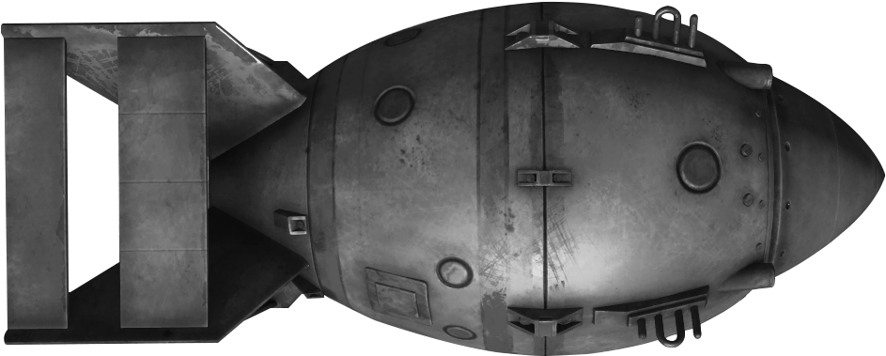
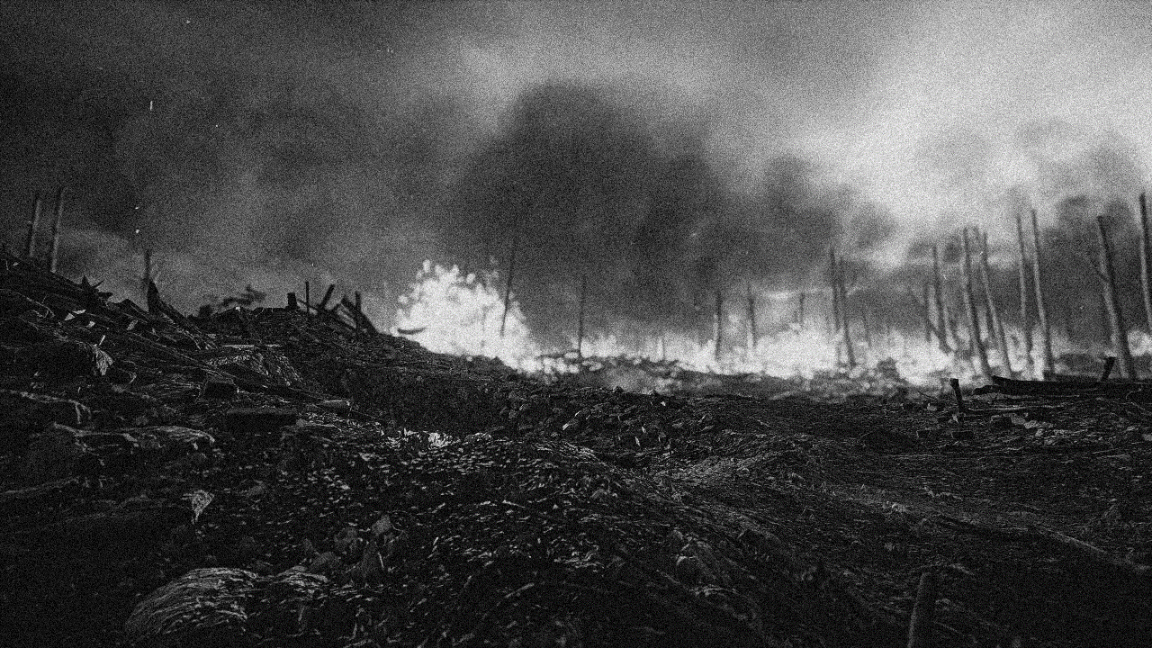
CPE-311/312 EMBEDDED SYSTEM PROJECT >Turret<

Slide 2
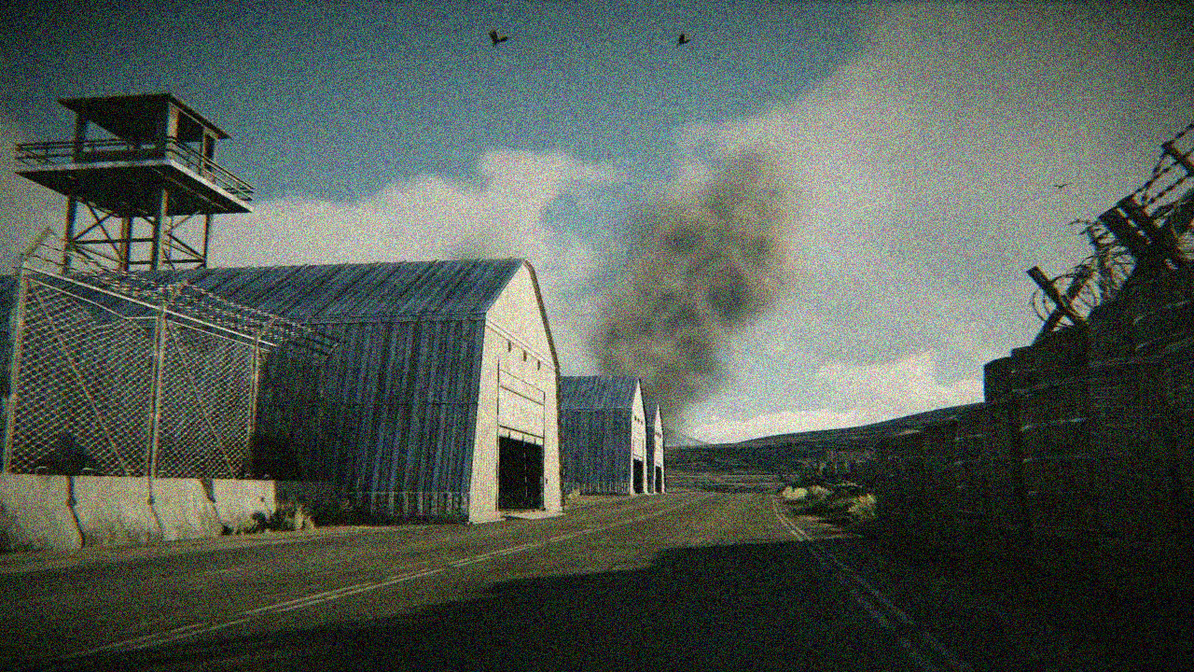




MEMBERS
ทินภัทร สุมานิตย์ 2111311409
พันกวี จุลกระเศียร 2111310609
พัชพล ผดุงพจน์ 2111311060
ณยศกร เพิ่มพูล 2011310303

Slide 3

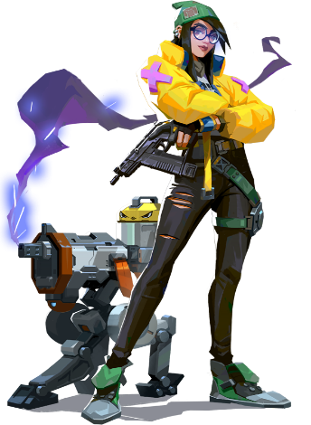
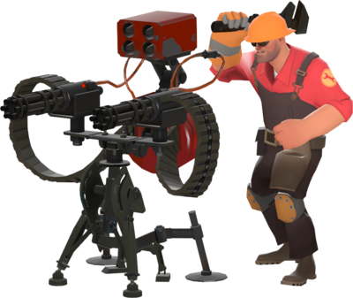
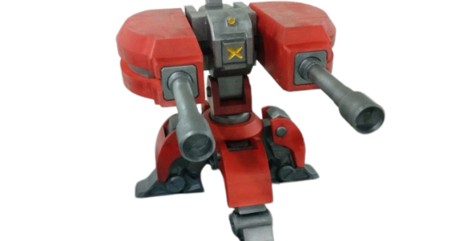
WHAT IS TURRET?

Slide 4
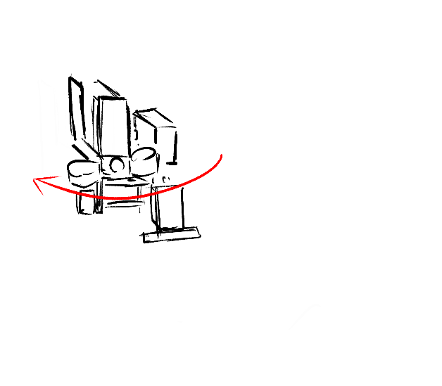
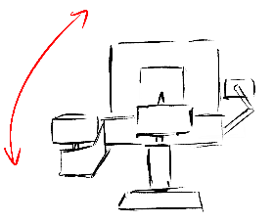
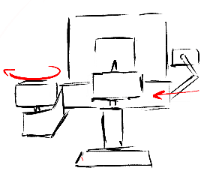
PROJECT OVERALL DIAGRAM

Slide 5
Requirement
Moving
Shoot
Communication
App Control
Horizontal 180 Degrees
5 loads
MQTT Protocol
Vertical 45 Degrees
Rate > 1 : 1 s
1 Degree : 20 ms

Slide 6
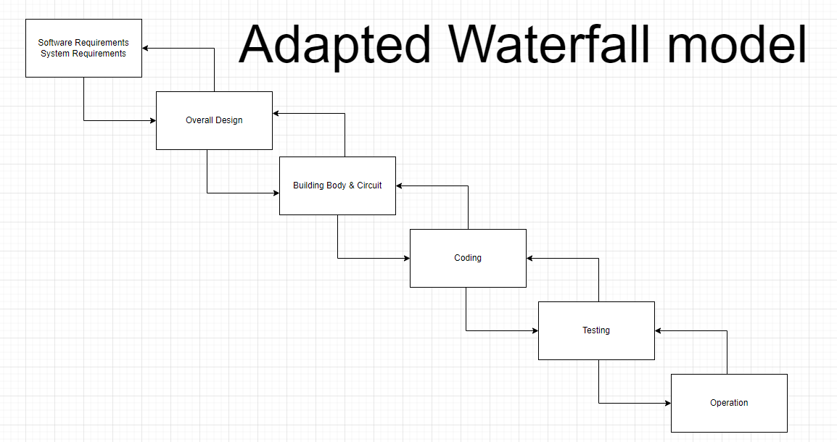
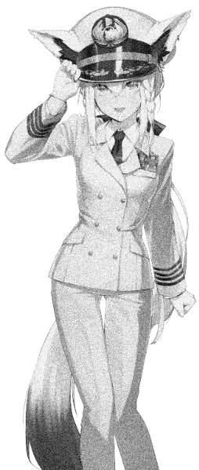
PROJECT PLAN

Slide 7
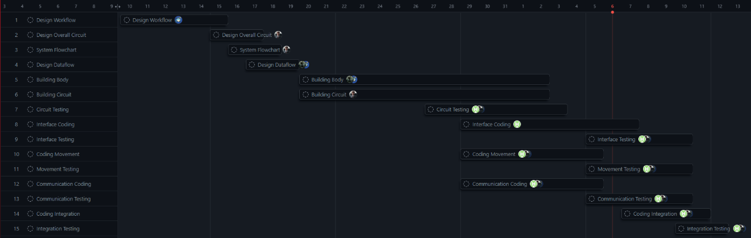
PROJECT PLAN

Slide 8
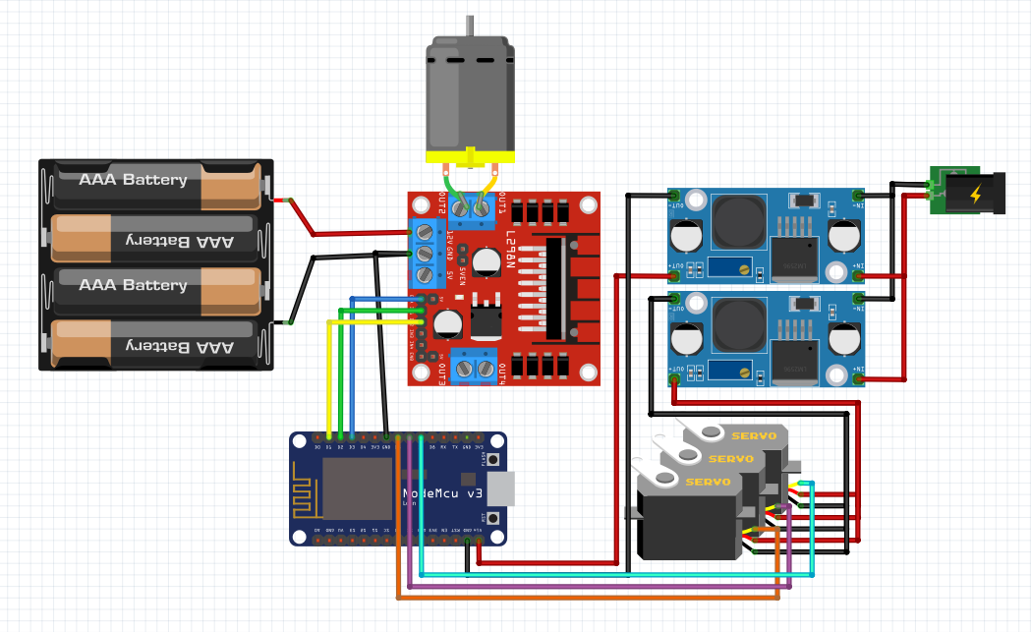
CIRCUIT DESIGN

Slide 9
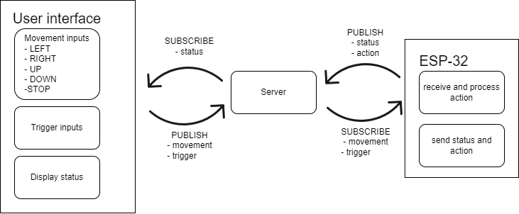
DATAFLOW

Slide 10
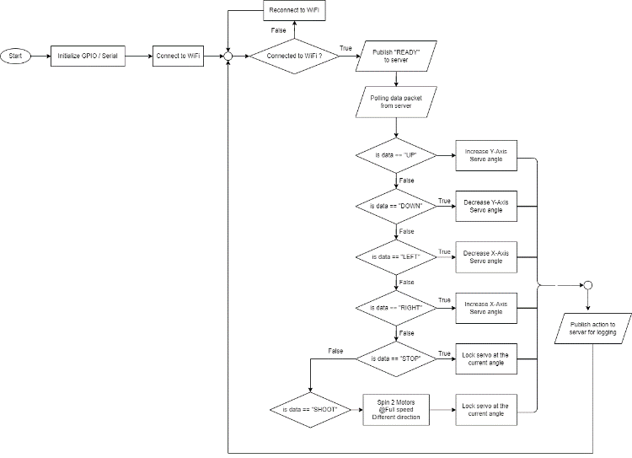
FLOWCHART

Slide 11
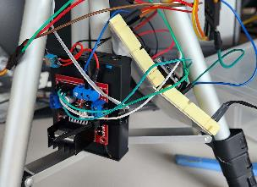
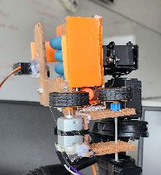
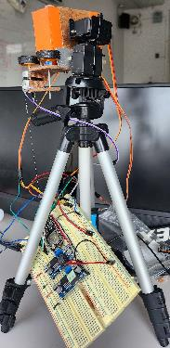
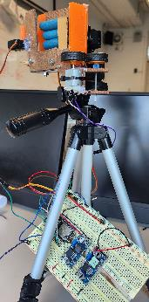
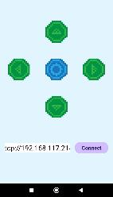
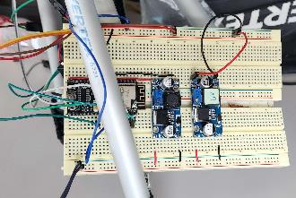
TURRET

Slide 12
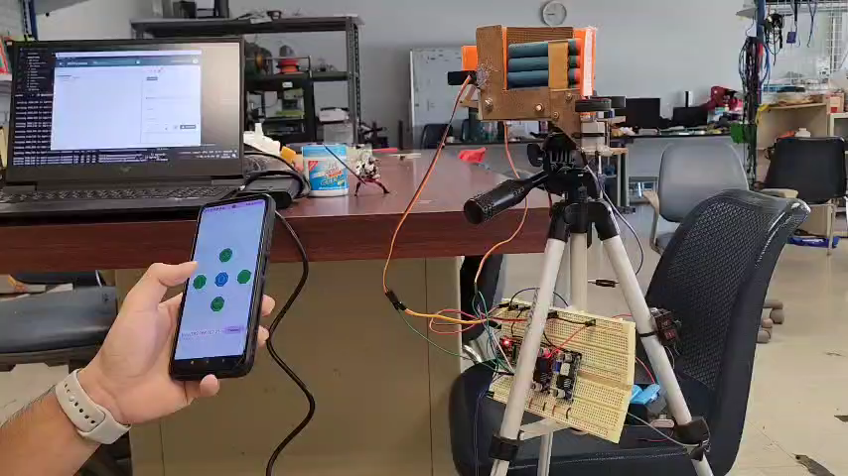
Turret Demo

Slide 13
PROBLEM & SOLUTION
Problem Power consumption problem
Problem : Motor driver circuit draw too much current
Solution : Use 2 separate source
1.) 12V1.5A for ESP32 & Servo
2.) 9V3.3A Battery for Motor & Motor Driver

Slide 14
PROBLEM & SOLUTION
2. I2C Addressing problem
Problem : Could not find I2C address for PCA9685 servo driver
Solution : Control servo without PCA9685
3. The wire
Problem : Not enough and broken jumper wire
Solution : Stealing

Slide 15

Conclusion
From the process of building the turret with ESP32 MCU we have learned how to control servo motor using PWM signal, control motor with H-bridge motor driver, writing real-time controlling program with freeRTOS, receiving and sending data via WIFI with MQTT protocol and finally Robotic body design and movement planning.

